Slide 1
Advanced Topics & Future Directions in Computer Vision
Exploring the next generation of learning paradigms — from unlabeled data to multimodal reasoning

Slide 2
Contents
01
02
The Core Challenge
Likely Shift in Near Future
03
04
Unlabeled Learning
Few-Shot Learning
05
06
Vision + Language Models
Key Takeaways

Slide 3
The Core Challenge
Modern computer vision has achieved remarkable milestones — yet most state-of-the-art systems remain fundamentally dependent on large volumes of manually labeled training data. This bottleneck is costly, time-consuming, and difficult to scale across domains.
Annotation Overhead
Limited Real-World Adaptability
The Path Forward
Labeling datasets at scale requires significant human effort, domain expertise, and ongoing quality control — creating substantial barriers to entry for resource-constrained research settings.
Addressing these limitations requires a fundamental rethinking of how vision systems acquire, structure, and transfer knowledge — motivating the three paradigm shifts ahead.
Supervised models generalize poorly beyond their training distribution. Deployment in dynamic, open-world environments exposes brittleness that annotation alone cannot resolve.

Slide 4



Major Paradigm Shifts Shaping the Near Future
The field is converging on three transformative directions that collectively move computer vision beyond its supervised learning foundations.
Unlabeled Learning
Few-Shot Learning
Vision + Language
Self-supervised and unsupervised techniques that extract rich representations directly from raw, unannotated visual data
Meta-learning and transfer strategies that enable rapid adaptation from minimal labeled examples by leveraging prior knowledge
Multimodal architectures that jointly ground visual perception in natural language, enabling richer reasoning and explainability

Slide 5
Unlabeled Learning
Self-supervised learning reframes the supervision signal itself. Rather than relying on human-assigned labels, these methods construct pretext tasks — predicting masked patches, rotations, contrastive pairs, or temporal relationships — directly from the raw image signal.
Self-Supervised Pretext Tasks
Representation Quality
Masked autoencoders, contrastive objectives, and predictive coding
Transferable, semantically rich embeddings from raw pixels alone
Landmark architectures such as SimCLR, MoCo, DINO, and MAE have demonstrated that representations learned without any annotation can match or exceed those trained with full supervision on downstream benchmarks.
Zero Annotation Required
No manual labeling pipeline — training is driven entirely by data structure

Slide 6
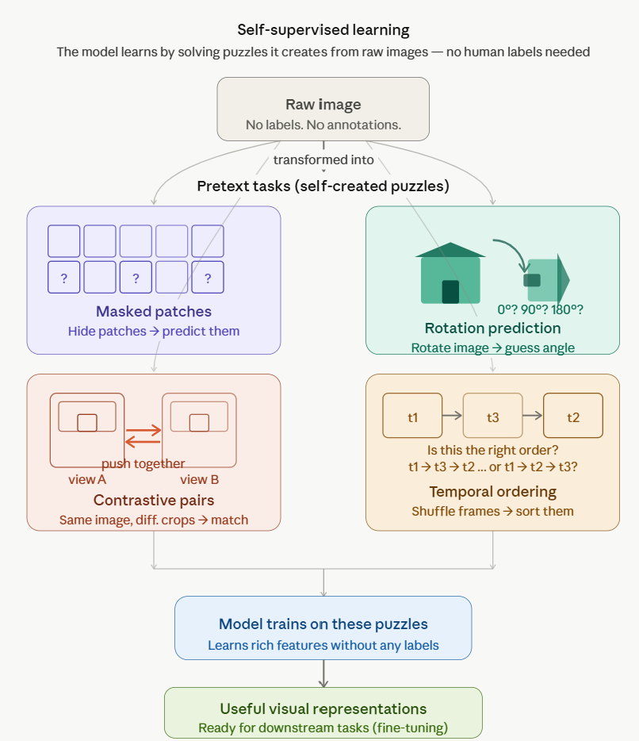
Unlabeled Learning
By solving these puzzles over millions of images, the model is forced to understand shapes, textures, and visual structure. When later given labeled data for a specific task (like detecting tumors or classifying objects), it already has a head start.

Slide 7

Why Unlabeled Learning Matters
Scales with Massive Data
Reduces Annotation Cost
Healthcare & Remote Sensing
Unlabeled images are abundant on the internet and in organizational archives. Self-supervised methods exploit this resource directly, enabling training on orders of magnitude more data than labeled corpora permit.
Eliminating or dramatically reducing manual labeling lowers the barrier to building high-quality vision models — making advanced CV accessible to smaller teams and specialized domains.
In radiology and satellite imaging, labeled data is scarce and expensive. Self-supervised pretraining on large unlabeled archives delivers strong initialization for downstream diagnostic and geospatial tasks.

Slide 8
Few-Shot Learning
Few-shot learning operationalizes a defining feature of human cognition: the ability to recognize a new visual concept from one or two examples, by leveraging structured prior knowledge rather than brute-force statistics.

Slide 9
Why Few-Shot Learning Matters
Handles Rare & Novel Classes
Healthcare & Fraud Detection
Human-Like Generalization
By separating task-specific learning from meta-level learning, these systems exhibit a more cognitive, flexible form of intelligence — adapting to new visual concepts with minimal supervision.
In domains where certain categories are inherently rare — emerging disease subtypes, uncommon manufacturing defects — few-shot methods enable recognition without waiting for large annotated datasets to accumulate.
Clinical imaging and financial fraud present severe class imbalance and sparse positive examples. Few-shot frameworks provide principled mechanisms to build effective classifiers under these constraints.

Slide 10
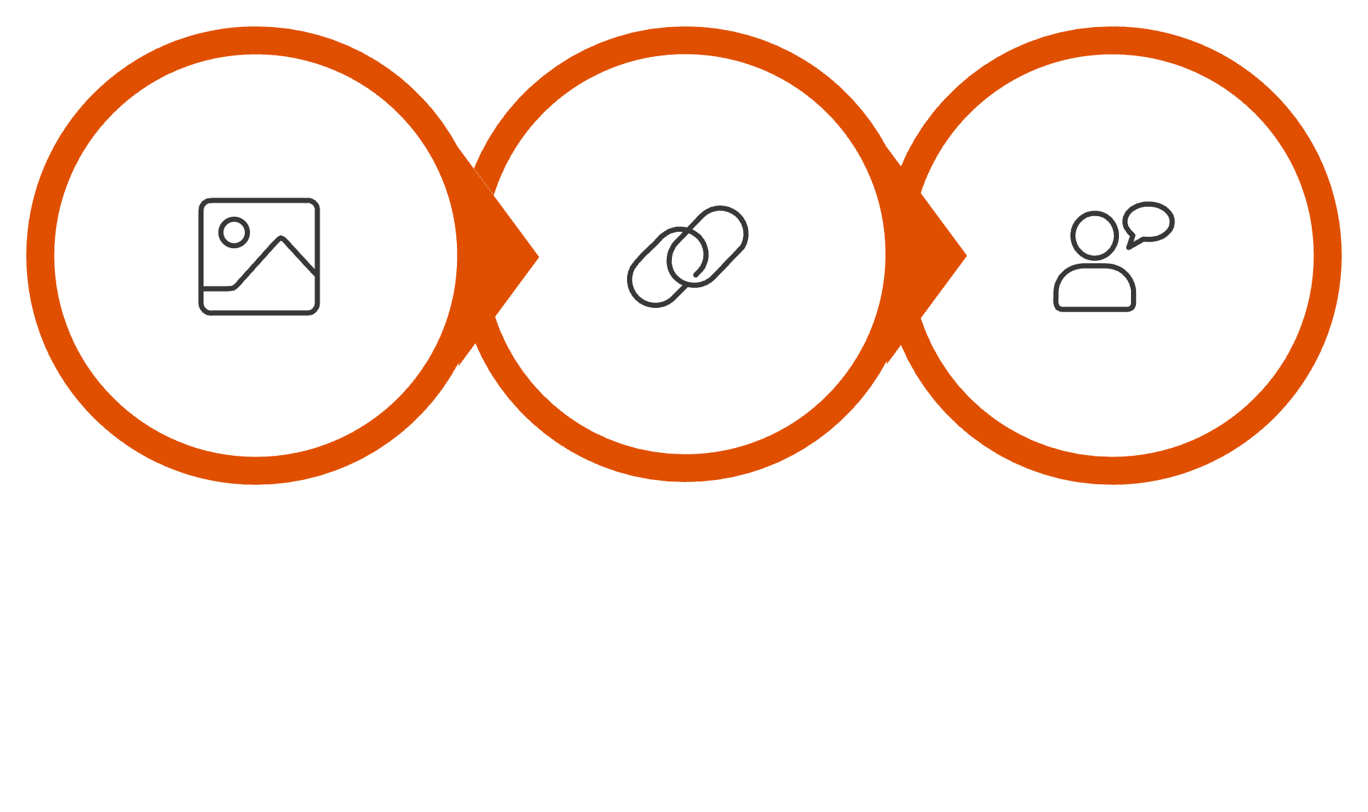
Vision + Language: Multimodal AI
The convergence of visual perception and natural language processing represents one of the most consequential developments in contemporary AI. Models such as CLIP, ALIGN, Flamingo, and GPT-4V jointly encode images and text within a shared semantic space, enabling grounded, cross-modal understanding.
Language-Guided Reasoning
Visual Encoding
Cross-Modal Alignment
This architecture enables zero-shot transfer, open-vocabulary detection, visual question answering, and language-conditioned generation — capabilities unavailable to unimodal vision systems.

Slide 11
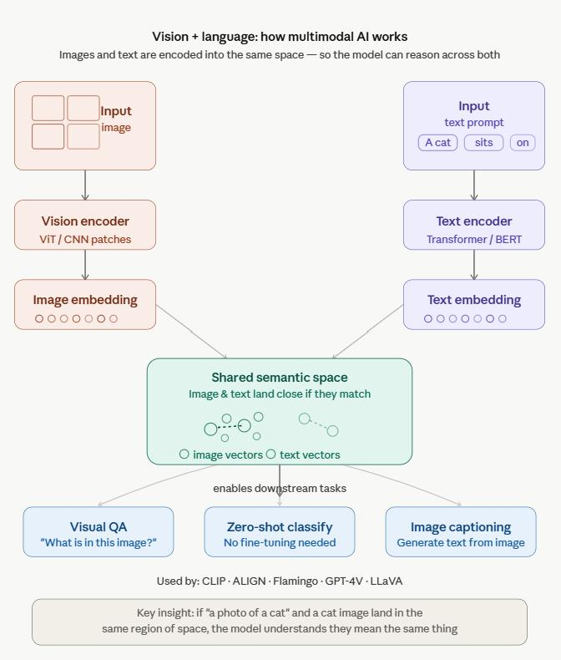
Vision + Language: Multimodal AI
Vision + Language Multimodal AI encodes images and text into a shared semantic space, so matching pairs — like a photo of a cat and the phrase "a cat" — land close together as vectors. This alignment enables powerful cross-modal capabilities: visual question answering, zero-shot classification, and image captioning, without needing separate systems for vision and language.

Slide 12
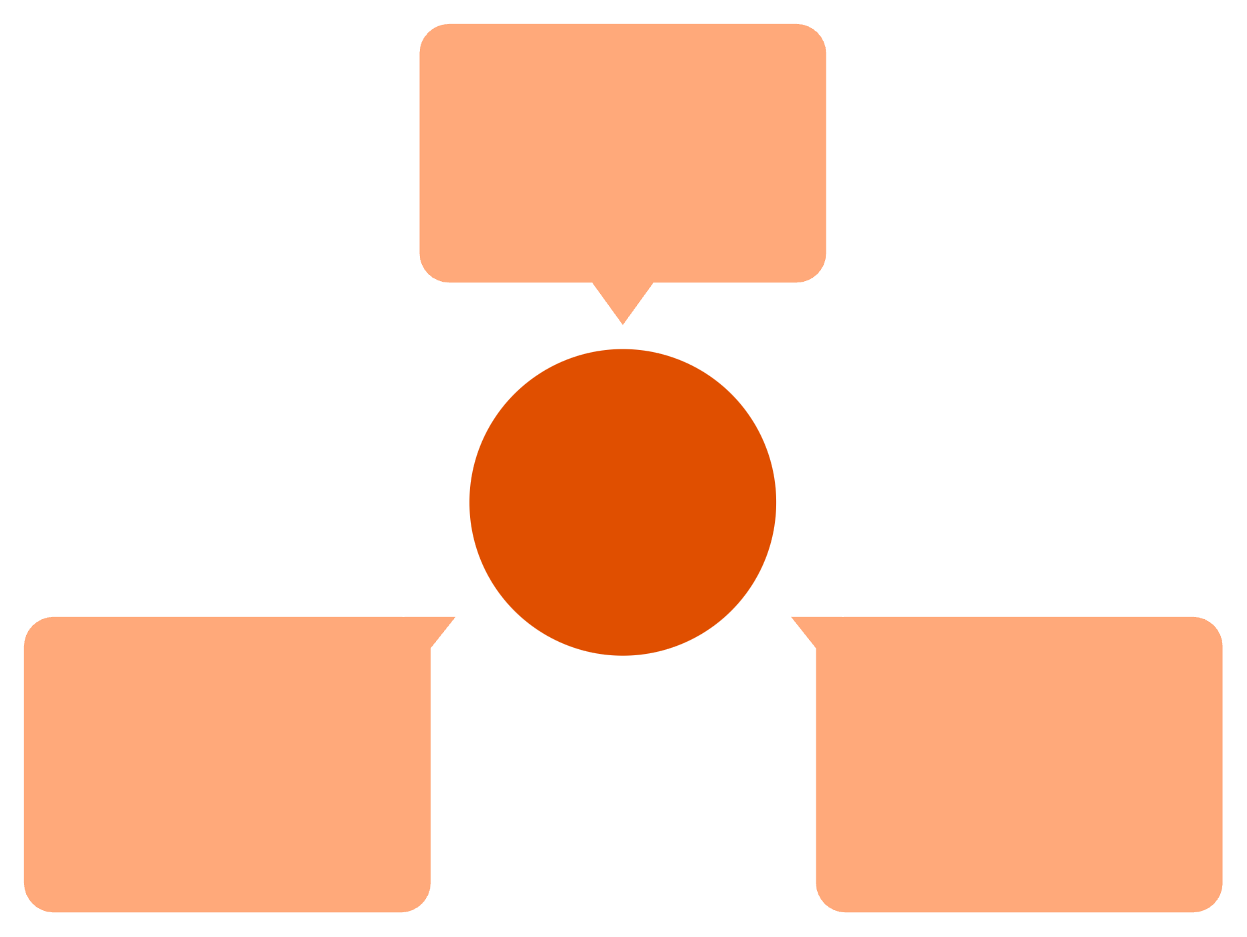
Key Takeaways
Unlabeled Learning
Self-supervised, scalable
The Future of Vision
Vision + Language
Few-Shot Learning
Multimodal, explainable
Meta-learning, efficient

